Slide 1

K-Means Fuzzy
Time Series Forecasting
An AI6124 Final Project Presentation by
Reinelle Jan C. Bugnot
G2304329L
bugn0001@e.ntu.edu.sg
Nov. 2023

Slide 2
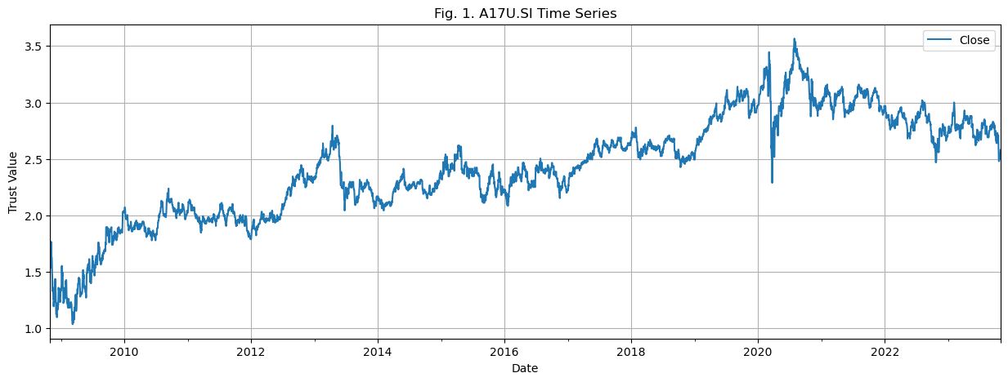
Chosen Dataset
CapitaLand Ascendas Real Estate Investment Trust (REIT)
15 year range, 1-day resolution
Preprocessing Step: Forward Fill missing data corresponding to Weekends and Holidays

Slide 3

Chosen Hybrid AI Method
K-Means Fuzzy Time Series
Reference Paper by Alyousifi, et. al.

Slide 4
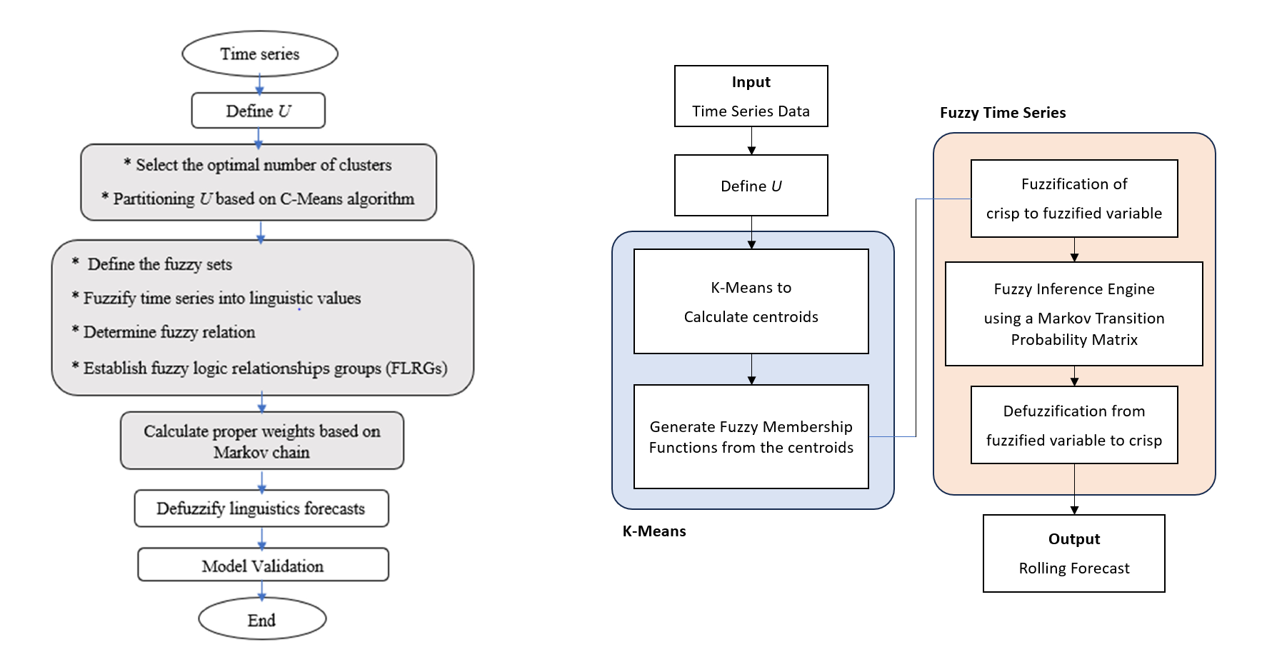
Chosen Hybrid AI Method
C-Means Fuzzy Time Series Model
(by Alyousifi, et. al.)
K-Means Fuzzy Time Series Model
(my implementation)

Slide 5
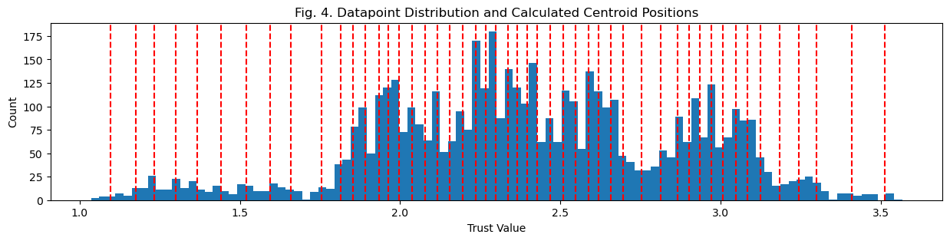
K-Means Clustering Algorithm
Generate Centroids. 1-dimensional K-Means clustering that clusters the datapoint on the vertical axis dimension (‘Trust Value’) based on a given number of centroids specified by the parameter k.

Slide 6
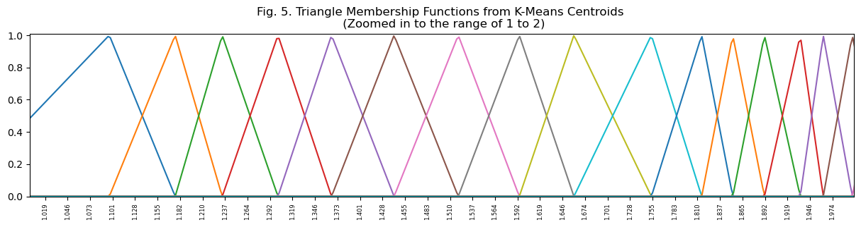
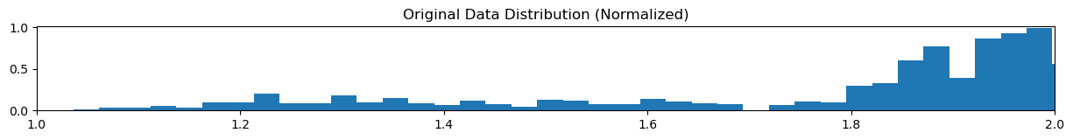
K-Means Clustering Algorithm
Generate Membership Functions. From the generated centroids, we can generate triangular membership functions specified by parameters [a, b, c] where a is the centroid of the previous mf, b is the centroid of the current mf, and c is the centroid of the next mf.
Note how the membership functions are more tightly packed in areas with high data distribution!

Slide 7
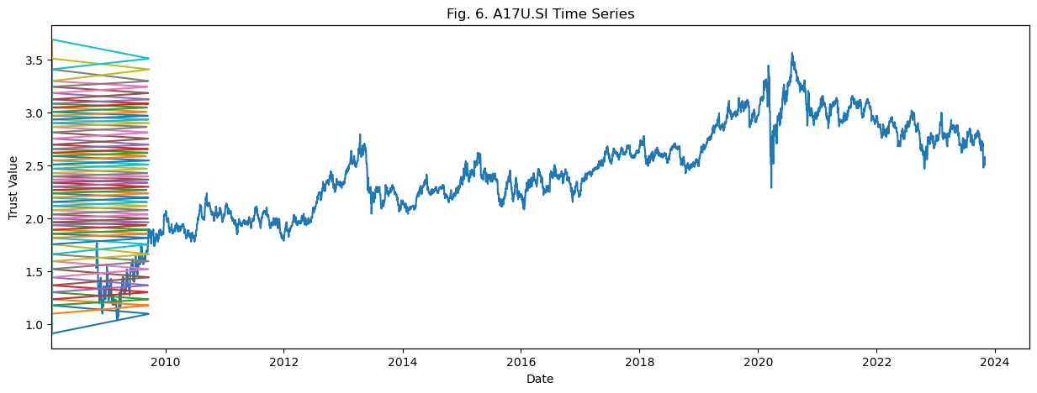
K-Means Clustering Algorithm
Membership Functions with respect to the input time series.

Slide 8
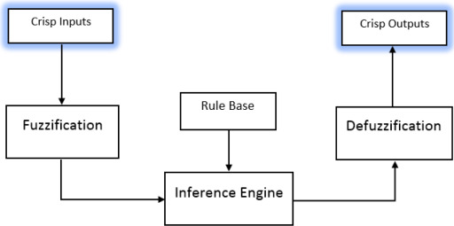
Fuzzy Time Series Algorithm
A crisp input goes through a fuzzification process that converts it into its corresponding fuzzified variable, which then goes to a fuzzy inference engine. Based on a set of fuzzy rules, the inference engine outputs a new fuzzified variable that is then converted back to its crisp value via a defuzzification process.
Basic Components of a Fuzzy Inference System.

Slide 9
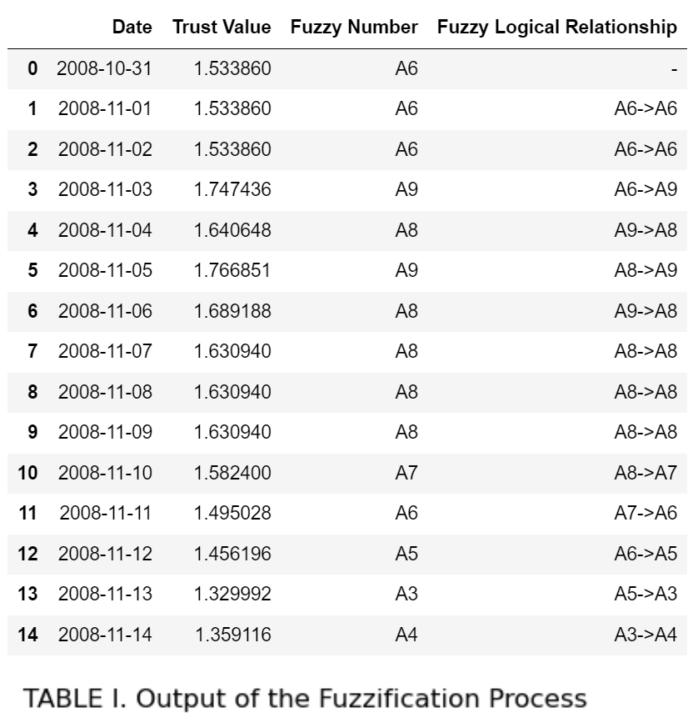
FTS: Fuzzification
Converting crisp input to fuzzified variables.
Fuzzy Logical Relationships (FLRs) representing how each fuzzy variable ‘flow’ from one state to another
Crisp Input values representing our original time series data (train data)
Fuzzified Variables after Fuzzification

Slide 10
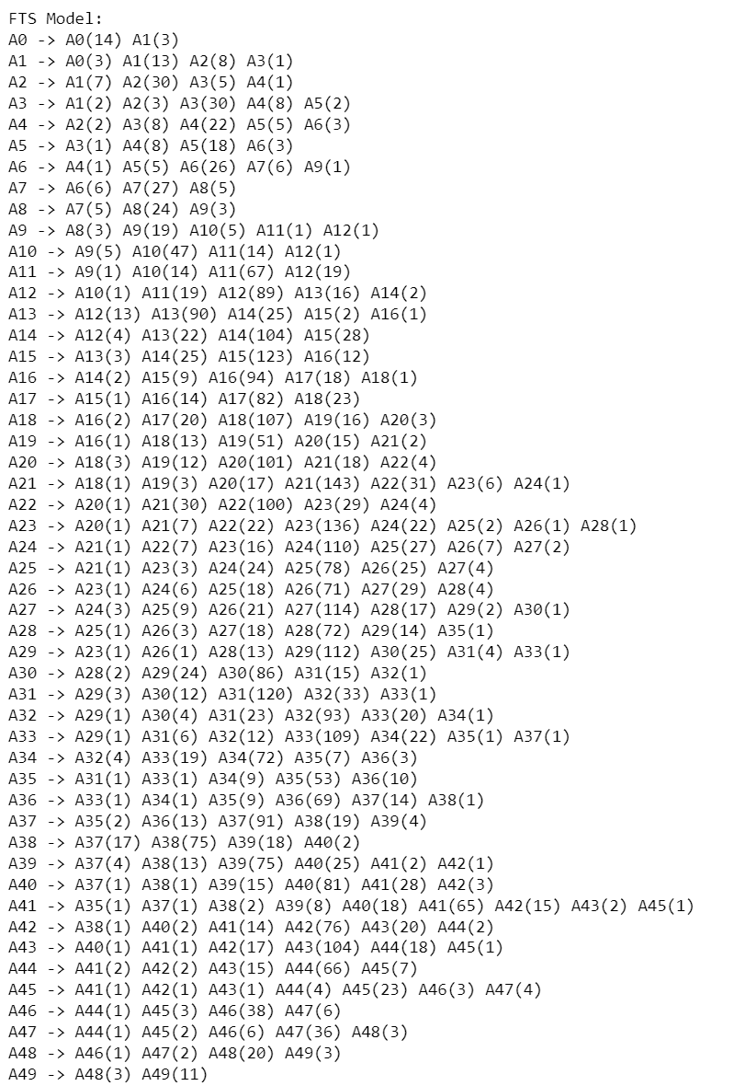
FTS: Inference Engine
The fuzzy rules are derived by grouping the fuzzy logical relationships into groups, which is called the Fuzzy Logical Relationship Groups (FLRG), alongside the frequency associated with each fuzzy logical relationship
FLRGs tell us all the possible next states given the current state (input fuzzy variable)

Slide 11
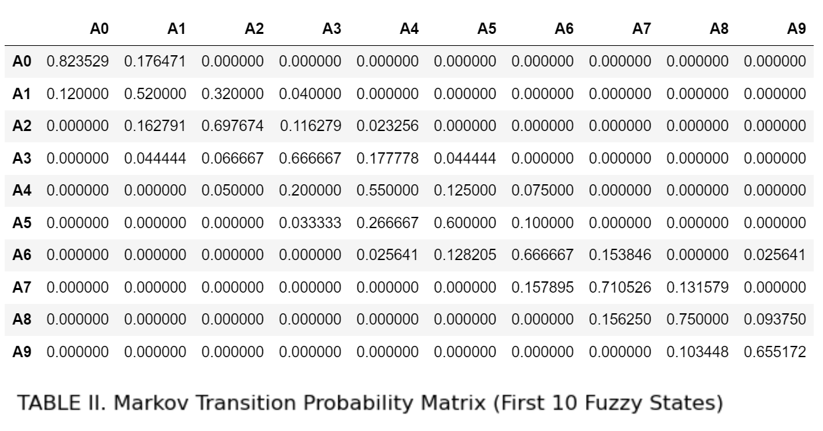
FTS: Inference Engine
We can better represent the FLRGs through a Markov Transition Probability Matrix, showing the probability that the next fuzzy variable is Ab given that the current fuzzy variable is Aa.

Slide 12
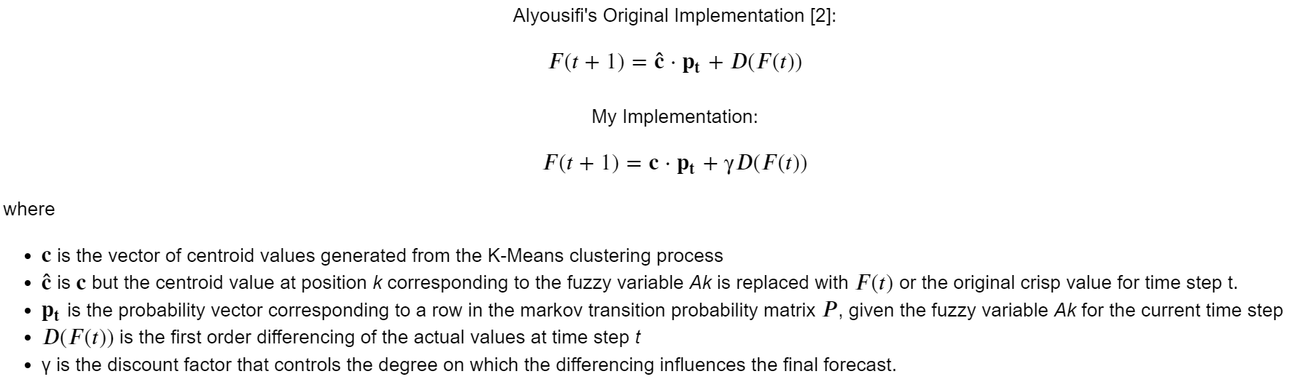
FTS: Defuzzification
Defuzzification, i.e. to converting the generated fuzzy variables generated by our fuzzy inference engine back to its corresponding crisp value (a.k.a the point forecast for time step t+1), can be performed using the following equation:
The logic behind my modification is to simplify the defuzzification process, as well as remove potential data leakage through the vector c-hat, hopefully making the algorithm much more robust.

Slide 13
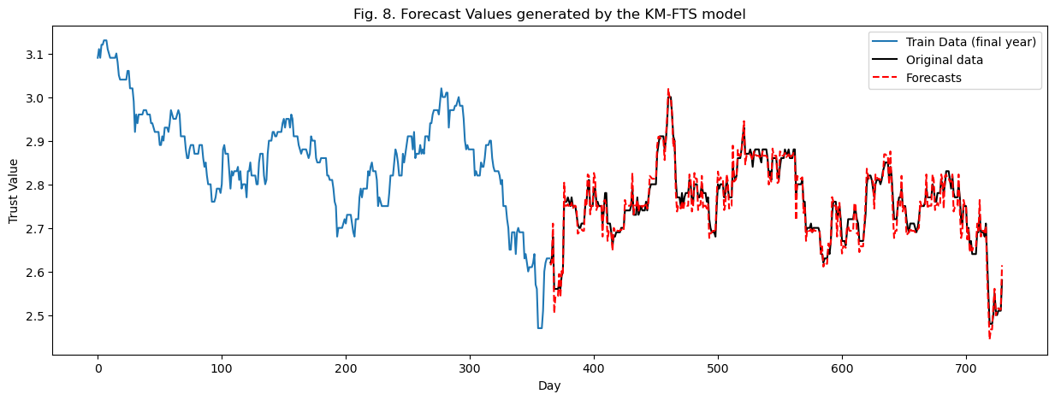
FTS: Defuzzification
From the output of the defuzzification process, we can generate rolling forecasts across the entire testing range.

Slide 14
Benchmarks
To validate the performance of our model, the generated hybrid KM-FTS model is benchmarked across 4 evaluation metrics (Mean Absolute Percentage Error (MAPE), Root Mean Square Error (RMSE), Thiels' U-statistics, and R-squared) against several models, namely:
BASE-RW: Base random walk model (today's price is tomorrow's price)
GRID-FTS25, GRID-FTS50, GRID-FTS100: Standard FTS model with 25, 50, and 100 partitions respectively. No K-Means clustering method was used to find the best positions of membership function centroids. Instead, the partitioning is set to be evenly distributed across the universe of discourse U.
Decision Tree: Decision Tree regressor with 4-fold cross validation.
LGBM: Light Gradient Boosting Model with 4-fold cross validation.

Slide 15
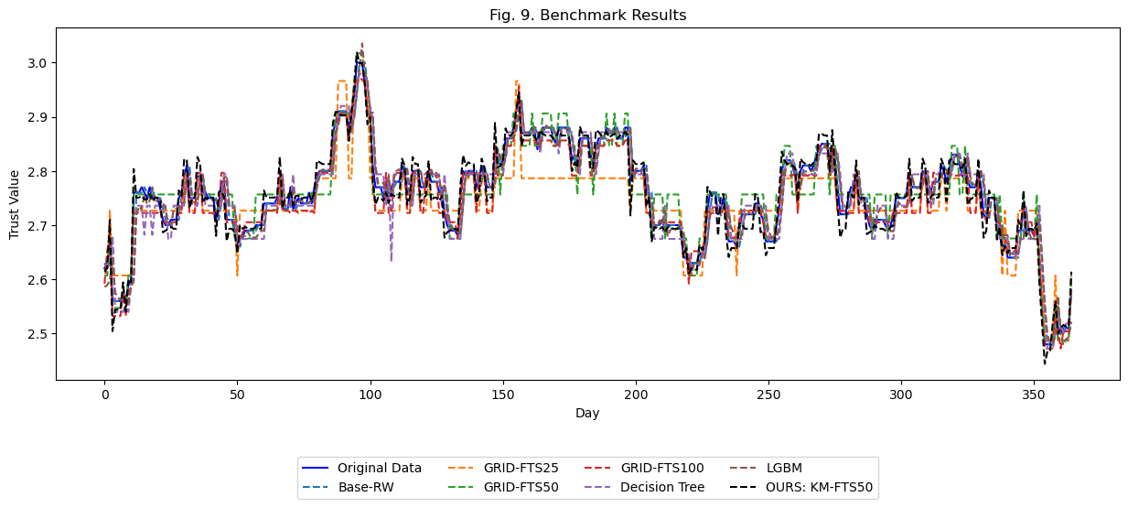
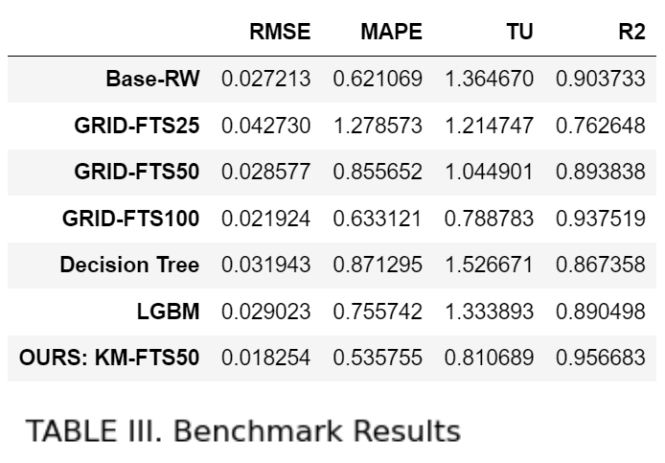
Analysis of Results
The hybrid KM-FTS model yields the best forecasting performance, generally surpassing the other models, according to the selected statistical benchmarks. Our KM-FTS model produced the lowest Root Mean Square Error (RMSE) and Mean Absolute Percentage Error (MAPE), and the highest R-squared value across all other models; only being out-performed by the GRID-FTS100 model in the Theil's U-statistic by a close margin.

Slide 16
Analysis of Results
KM-FTS outperforms GRID-FTS (implemented using the Chen Model in PyFTS), proving that the addition of K-Means algorithm to select centroid positions drastically improves model performance, as opposed to the uniform partitioning strategy in standard GRID-FTS.
This is because through the K-Means clustering method, we are able to identify areas of high and low concentration of values and are thus able to allocate more membership functions to more finely disaggregate the trend into a series of fuzzy logical relationships. In contrast, a uniform partitioning method implemented in standard FTS models will evenly allocate partitions, even in areas within our universe of discourse where data points are sparse, hence, producing more weakly associated fuzzy logical relationships.
Key Takeaway

Slide 17
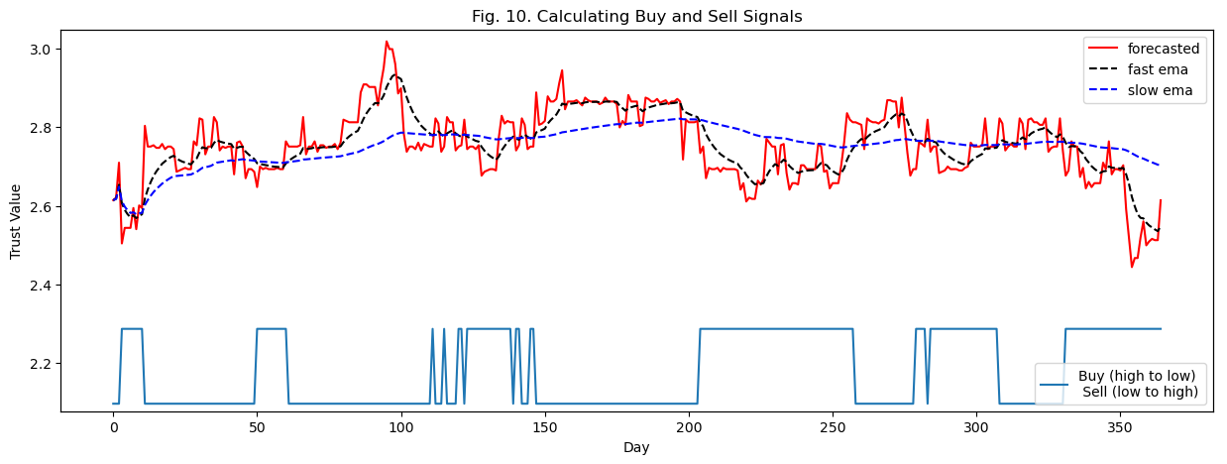
Making Money $$$
Generating Buy and Sell signals from the forecast plot requires the use of two moving averages (in this project, I chose exponential moving average or EMA): slow EMA and fast EMA. The difference is the number of periods to which the averaging is performed.
In this project, I found that the model performs best using a 12-day EMA (fast) and 132-day EMA (slow). We can define a buy signal whenever the slow EMA crosses below the fast ema, and a sell signal whenever the slow EMA crosses above the fast EMA

Slide 18
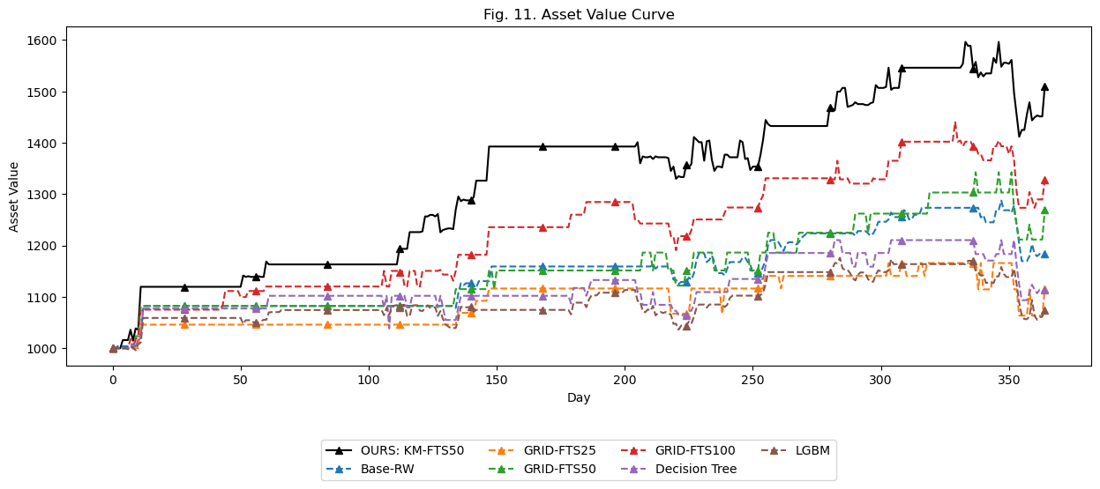
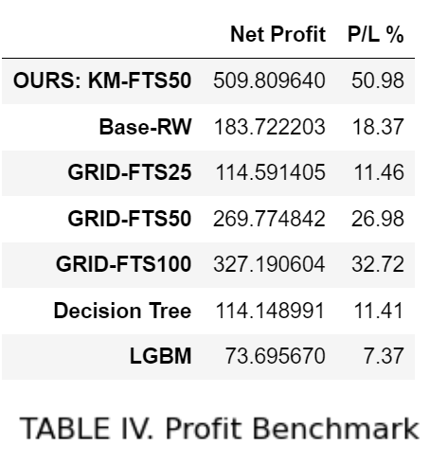
Making Money $$$: Benchmarks
To calculate profit and compare across the benchmark models, I created simple functions that:
Finds the best EMA parameters using grid search
Calculate trade positions (buy and sell signals) on the model’s forecast values using the best EMA parameters
Use a greedy trading strategy according to calculated signals (buy all / sell all)
Implementing steps 1-3 to the forecasted values of all the benchmark models, we get the following results:

Slide 19
Our portfolio grew by 50.98% over just 1 year!
Of course, it is not all sunshine and rainbows. While our model did net us a profit of $500+ from our initial $1000 investment in the simulation, in actual practice, forecasting models are not expected to perform as well. In fact, machine learning models rarely outperform stock indices over long periods of time. Most likely, the KM-FTS forecasting model we developed is tuned to only perform well on the specific dataset (A17U.SI) and on the specific data range the model was trained on.
Still, this project is a good illustration of how we can leverage machine learning and AI algorithms to analyze data in more ways than one. In the end, it is the trader’s responsibility to assess whether or not an opportunity to buy or to sell arises.
Trade responsibly.
Reinelle Jan C. Bugnot
G2304329L
bugn0001@e.ntu.edu.sg
MS AI – Nanyang Technological Univerisity

